Slide 1
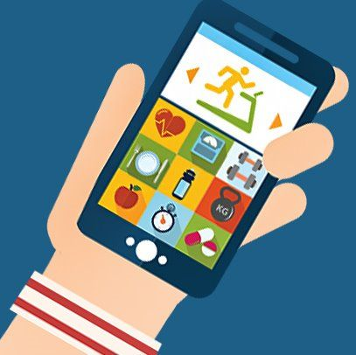
Health App
qTest Structure
Team 4
Release 1

Slide 2
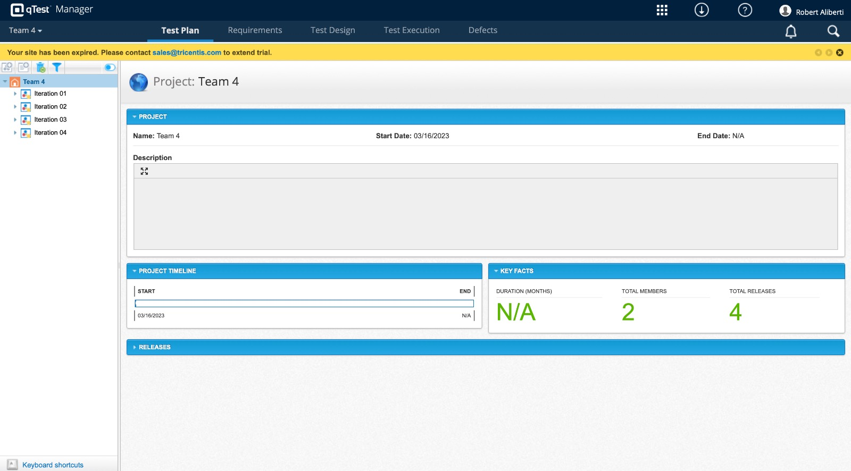

Slide 3
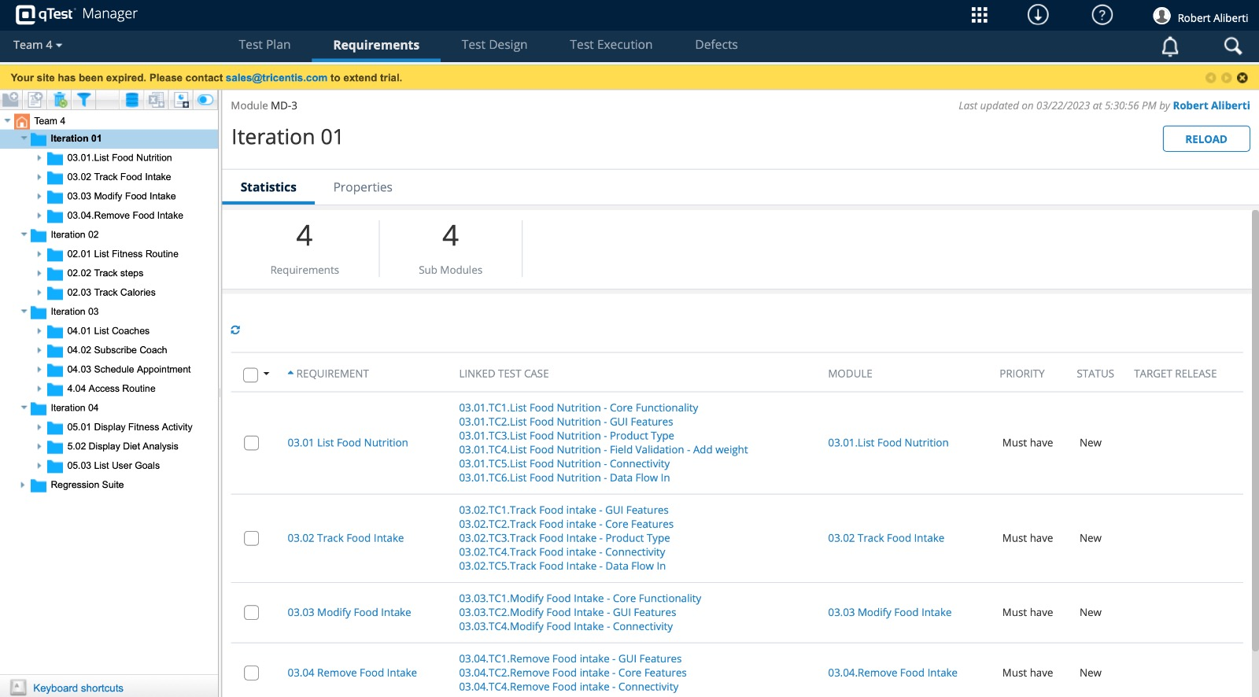

Slide 4
